Slide 1
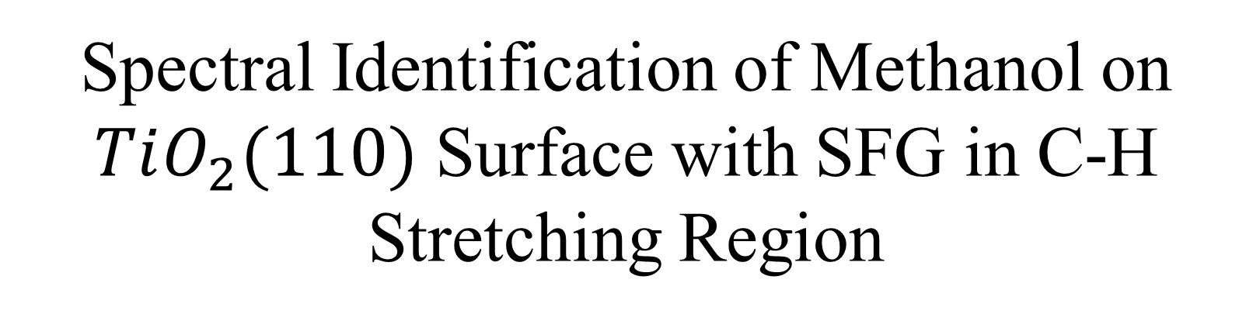
Spectral Identification of Methanol on $TiO_{2}(110)$ Surface with SFG in C-H Stretching Region
报告人（按姓氏拼音顺序）：
董济超
郭见青
李海龙
刘丹烁
信子鸣

Slide 2
Outline
Introduction
Brief Review of the Experiment
Result and Discussion
Summary and Outlook

Slide 3
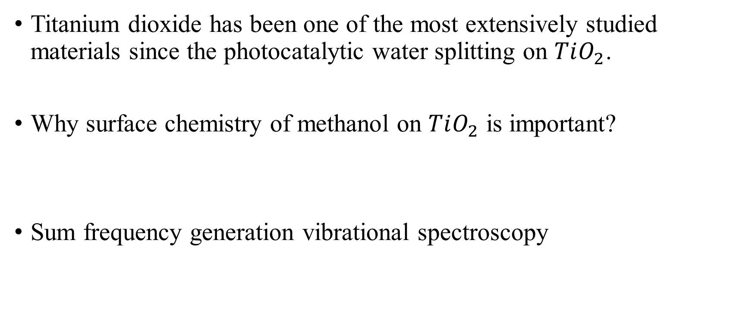
1. Introduction
Titanium dioxide has been one of the most extensively studied materials since the photocatalytic water splitting on $TiO_{2}$.
Why surface chemistry of methanol on $TiO_{2}$ is important?
Sum frequency generation vibrational spectroscopy
Notes:
In photosplitting reactions of water, pure TiO2 itself is not photocatalytically active, however the addition of methanol to water dramatically promotes the hydrogen production.
the fundamental understanding of photochemistry on this important surface.
Methanol is the simplest alcohol molecule, and the methanol/ TiO2 system is an ideal model to study the photocatalysis reaction of organic molecules on TiO2

Slide 4


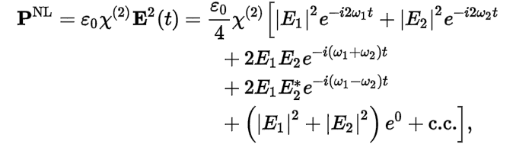
SFG
a second-order nonlinearity polarization vector
R. W. Boyd, Nonlinear Optics, third (Academic Press, New York, 2008).
second-harmonic generation, sum-frequency generation, difference-frequency generation and optical rectification

Slide 5
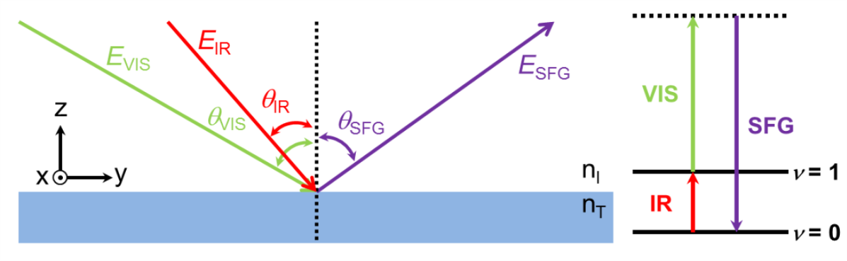
SFG progress

Slide 6
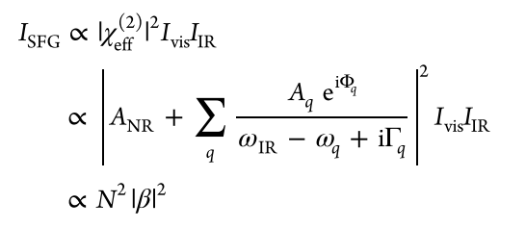
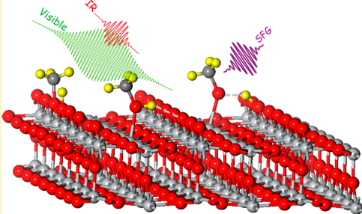
SFG
$β$ is the second-order molecular hyperpolarizability:

Slide 7

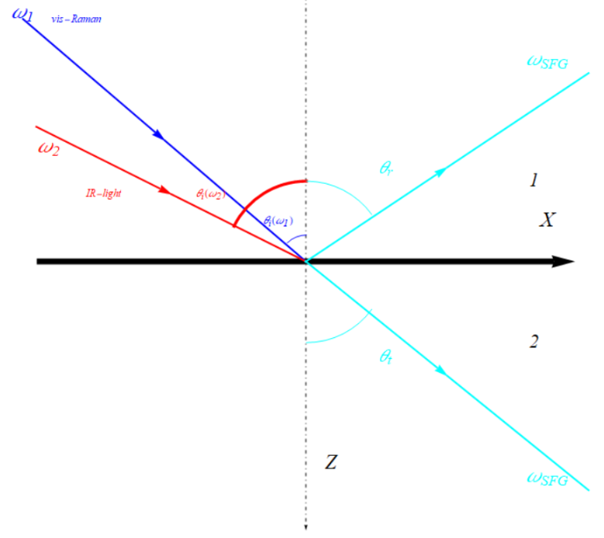





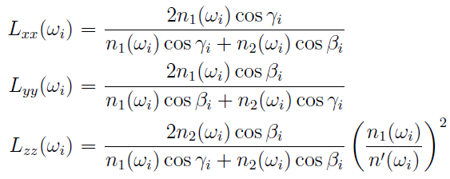
The Role of Polarization in SFG
The effect polarizability
Polarizability in the coordinate of interface :
  Point group:
  Nonzero factors: , , ,
Fresnel Factor:
P. Guyot-Sionnest. et.al Chem. Phys. Lett.. 1988, 144, 1-5

Slide 8
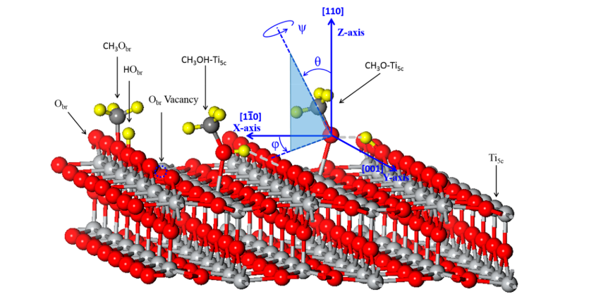

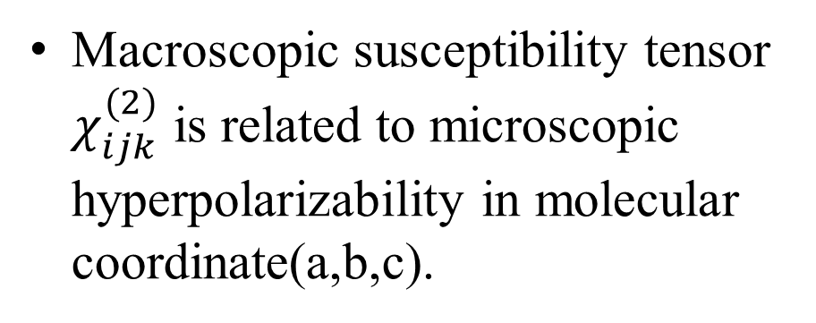
Macroscopic susceptibility tensor $χ_{ijk}^{(2)}$ is related to microscopic hyperpolarizability in molecular coordinate(a,b,c).
The macroscopic susceptibility of symmetric modes and antisymmetric modes can be obtained.
Notes:
the SFG spectra for the CH3OH/ TiO2(110) are very complicated since methanol can undergo both molecular and dissociative adsorption (methoxy) on TiO2(110)
different sites on TiO2(110), including five-coordinated titanium (Ti5c) and bridge-bonded oxygen (Obr), are available for the methanol adsorption

Slide 9
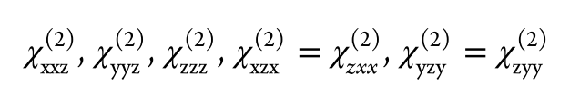
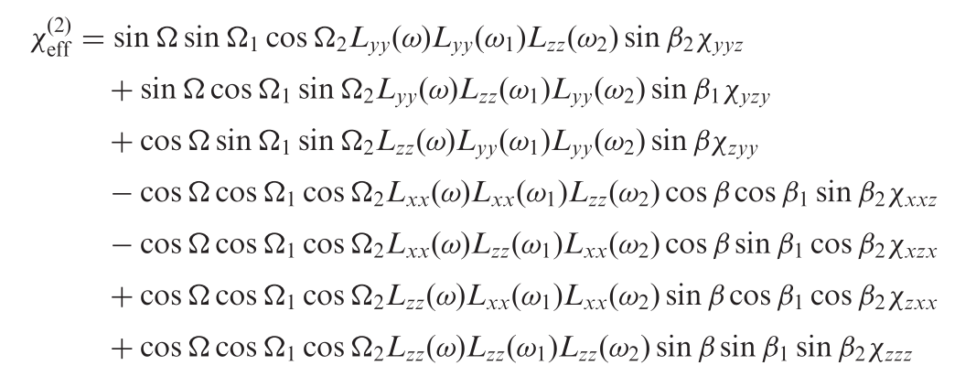

Macroscopic susceptibility tensor $χ_{ijk}^{(2)}$ is a third rank tensor
The$TiO_{2}(110)$ surface has a $C_{2v}$ symmetry

Slide 10

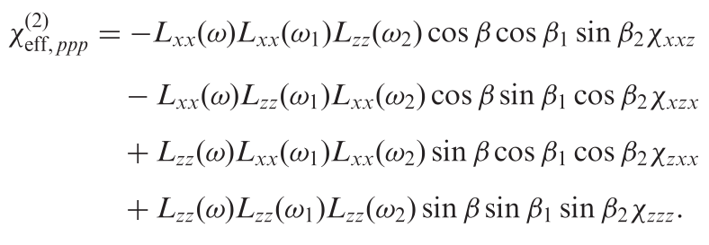
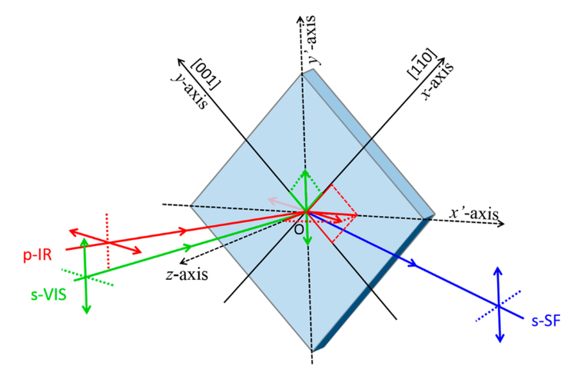
In this work(here, x-o-z plane is the incident plane)
because of the rotation angle, Euler
transformation is needed.

Slide 11
Some important properties of SFG
Interface/surface specificity:
1. Symmetry analysis of the second electric susceptibility:
2. Inversion operation analysis:

Slide 12
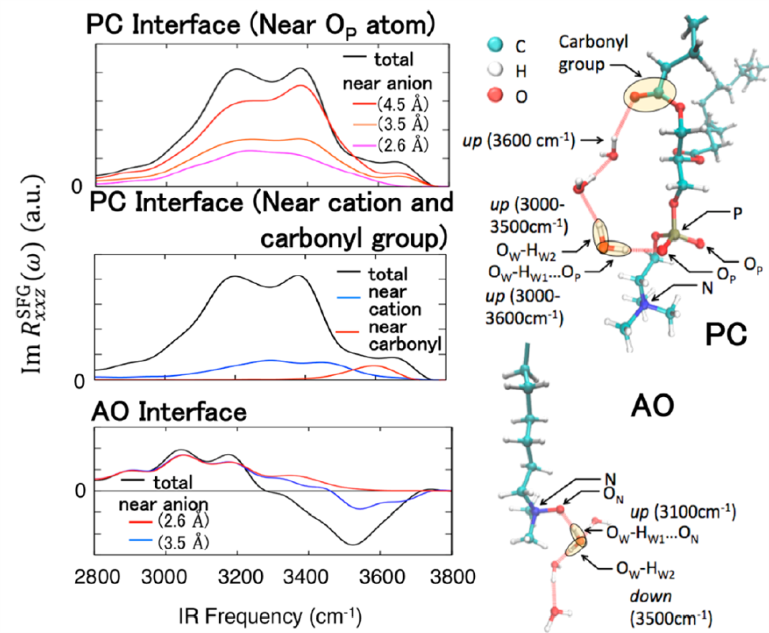
Some important properties of SFG
SFG is induced by visible-light and IR light, the energy is very low, can do little damage to even living biological systems.
“Integration of CNS survival and differentiation by HIF2α,” Cell Death and Differentiation, Vol.18, 1757-1770, 2011.
“In vivo long-term continuous observation of gene expression in zebrafish embryo nerve systems by using harmonic generation microscopy and morphant technology,” Journal of Biomedical Optics, Vol. 13, 064041, 2008.
J. Phys. Chem. Lett. 2015, 6, 4499−4503

Slide 13
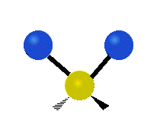
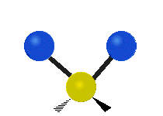
symmetric and antisymmetric stretching
Symmetric | Antisymmetric
Symmetric stretching | Antisymmetric stretching
Figures from: Wikipedia

Slide 14
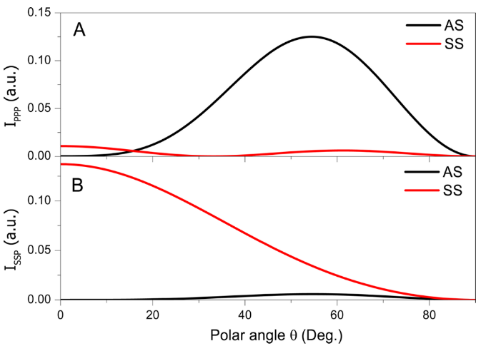
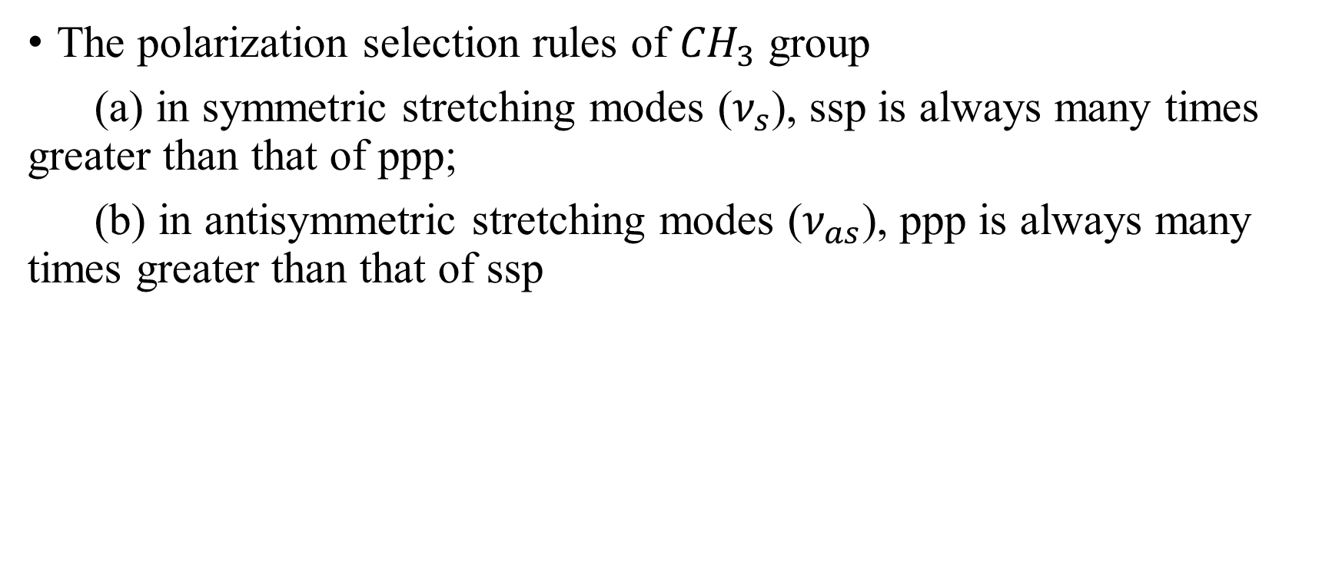
The polarization selection rules of ${CH}_{3}$ group
(a) in symmetric stretching modes ($ν_{s}$), ssp is always many times greater than that of ppp;
(b) in antisymmetric stretching modes ($ν_{as}$), ppp is always many times greater than that of ssp

Slide 15
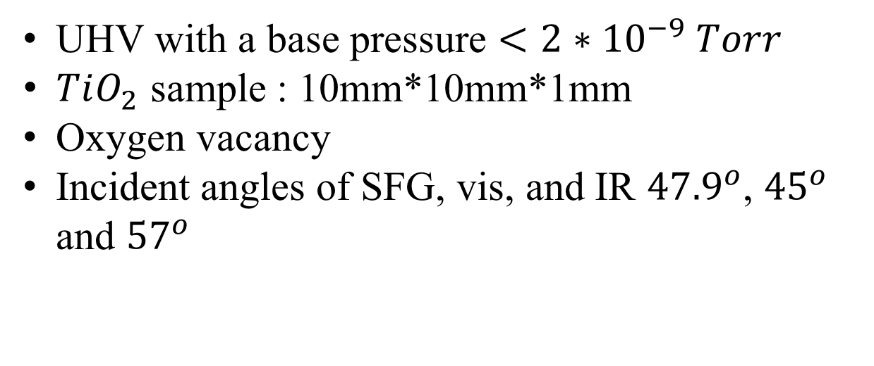
2. Brief Review of the Experiment
UHV with a base pressure $<2∗{10}^{−9} Torr$
$TiO_{2}$ sample : 10mm*10mm*1mm
Oxygen vacancy
Incident angles of SFG, vis, and IR ${47.9}^{o}$, ${45}^{o}$ and ${57}^{o}$

Slide 16
3. Result and discussion
3.1 Polarization-Dependent SFG Measurements.
3.2 Coverage-Dependent SFG Measurements.
3.3 UV Irradiation Treatment.
3.4 SFG Measurement of Methoxy at O_{br} Sites.

Slide 17
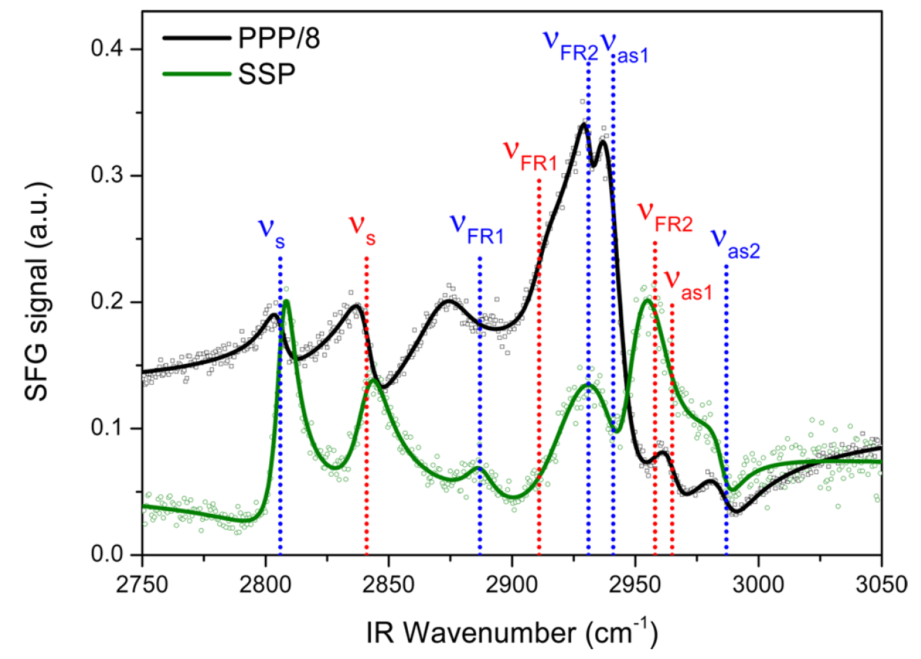
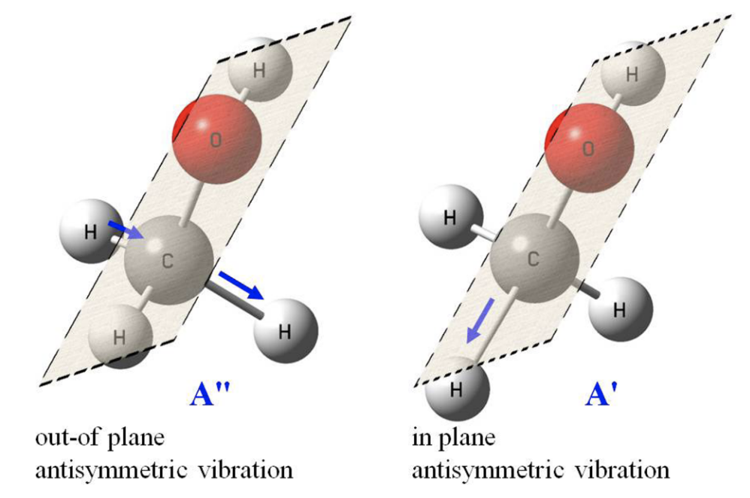
3.1 Polarization-Dependent SFG Measurements
Fig 1. SFG spectra of ppp and ssp polarizations on
methanol on TiO₂(110) at one layer coverage.
Figure from: Yu, Y. et al. J. Phys. Chem. A 2013, 117, 4377−4384.
Notes:
首先介绍一下，这里s，as，fr的含义。S代表的是前面说过的symmetric mode, as 代表antis mode，as1代表out-of plane as，as2代表in. fr是费米共振，在这里我们不予考虑。
对ssp偏振是用七个峰的绿色曲线拟合的，蓝色s，FR1，FR2峰和红色s，FR2峰的指认是trivial的，因为前面说了，SSP偏振下，as是非常弱的，后面的峰只可能是FR峰。2986波数附近有一个小凸起，这个峰可能是红色as，也可能是蓝色as，后面会进一步确定这个峰其实是红色的as1峰。
对ppp偏振是用七个峰的黑色曲线拟合的，和上面一样，只不过在ppp偏振下，as峰比较强，因此蓝色as1，as2和红色as1都比较容易指认。同时，蓝色FR2和红色FR1出的峰非常宽，其实是因为这两个峰靠的太近叠加而成的，后面会让这两个峰分开证明这个说法。
另外，这里的as有三个，存在能级劈裂行为。as1代表out-of plane as，as2代表in，如图所示，这两种模式能量是不一样的，因此出现劈裂。红色as2可能是由于太弱了，所以没有探测到。这三个as峰后面的实验会进一步确认。

Slide 18
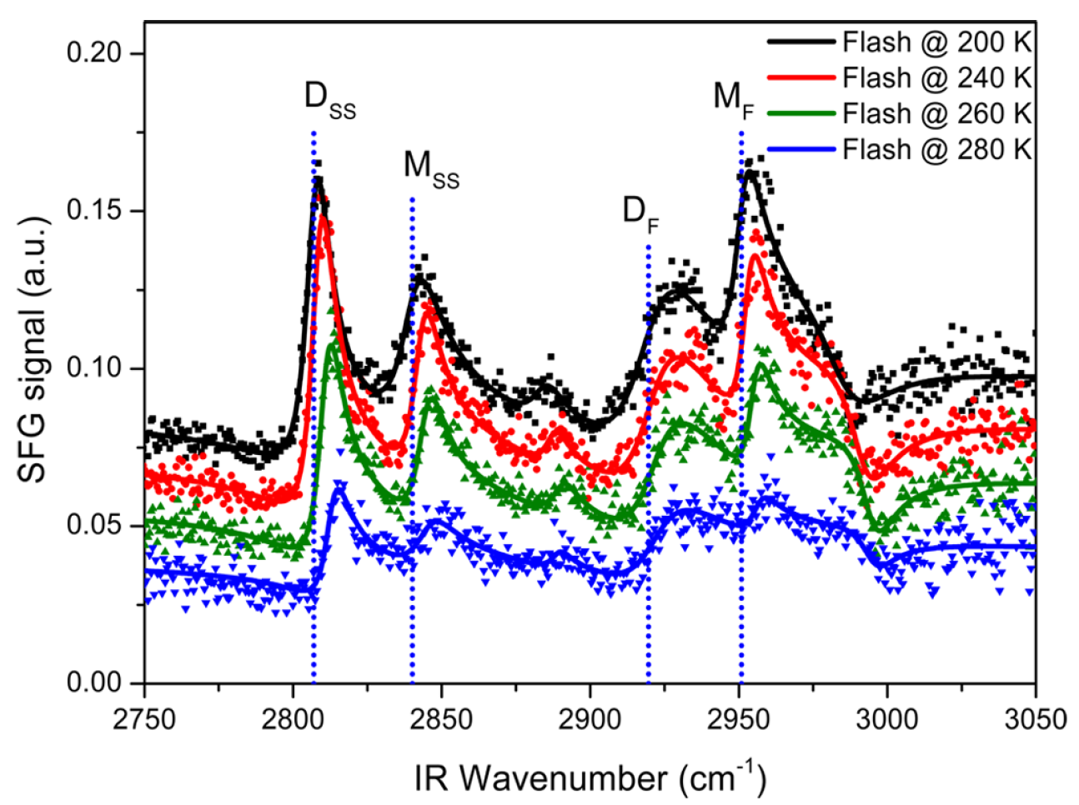
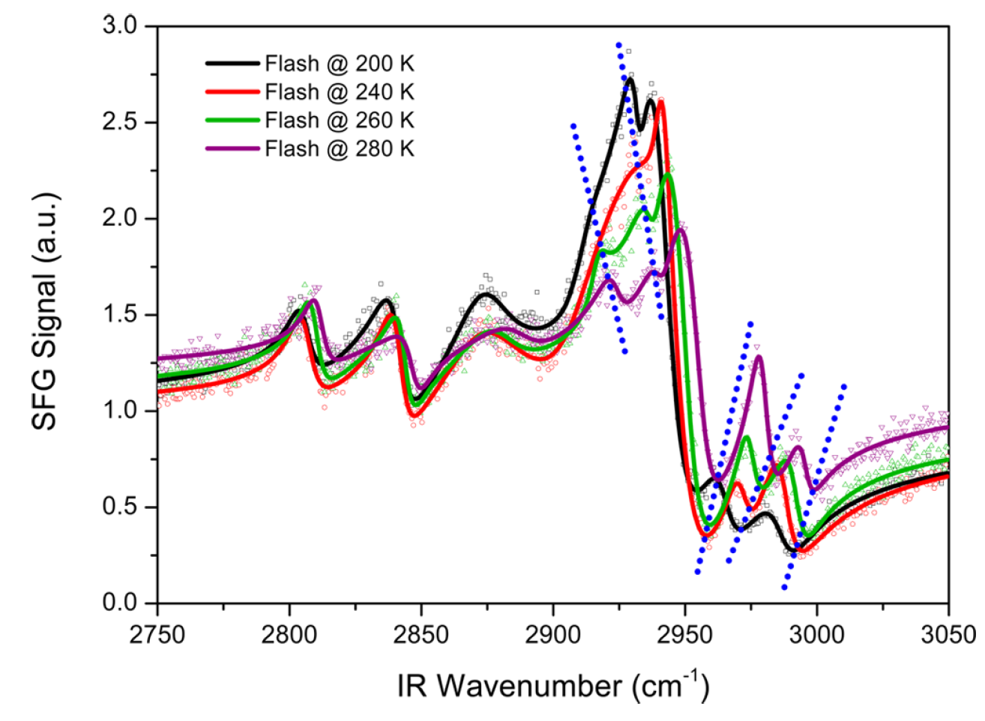
3.2 Coverage-Dependent SFG Measurements
Fig 2. SFG spectra of ssp and ppp polarization combination
on CH₃OH/TiO₂(110) at different methanol coverages.
Notes:
曝光温度越高，甲醇表明覆盖率越低。SFG对甲醇覆盖率的依赖如图所示，主要看右图。第一，随着coverage降低，刚才提到的两个叠加在一起的FR峰逐渐分离，证明确实是两个峰叠加成了一个宽峰。第二，随着coverage降低，两种偏振下的峰位都发生蓝移，这是因为甲醇覆盖率降低，分子间排斥作用降低。

Slide 19
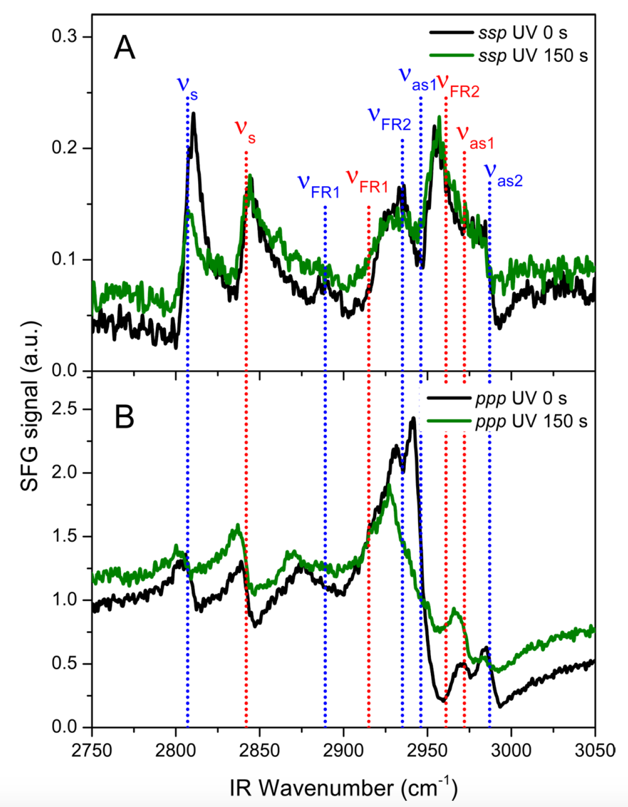
3.3 UV Irradiation Treatment
Fig 3. SFG vibrational spectra with ssp (A) and ppp (B) polarization on
CH₃OH/TiO₂(110) before and after 150 s of UV irradiation at 400 nm.
Notes:
接下来做的事情就是检验我们一开始的指认，具体来说就是对样品进行紫外放射处理。由于CH3O站位的甲醇已经被证明是具有光学活性的物质，而以分子形式吸附的甲醇则是非活性的。因此，受光照后峰强明显降低对应的是CH3O站位的甲醇，峰强不变甚至升高的对应的是以分子形式吸附的甲醇，这与前面我们对峰的指认结果是一致的。
另外，我们看到ssp偏振下as1处的峰在照射前后没有发生明显变化，说明它是红色的as1而不是蓝色的as2，证明了前面对这个峰的指认是正确的。

Slide 20
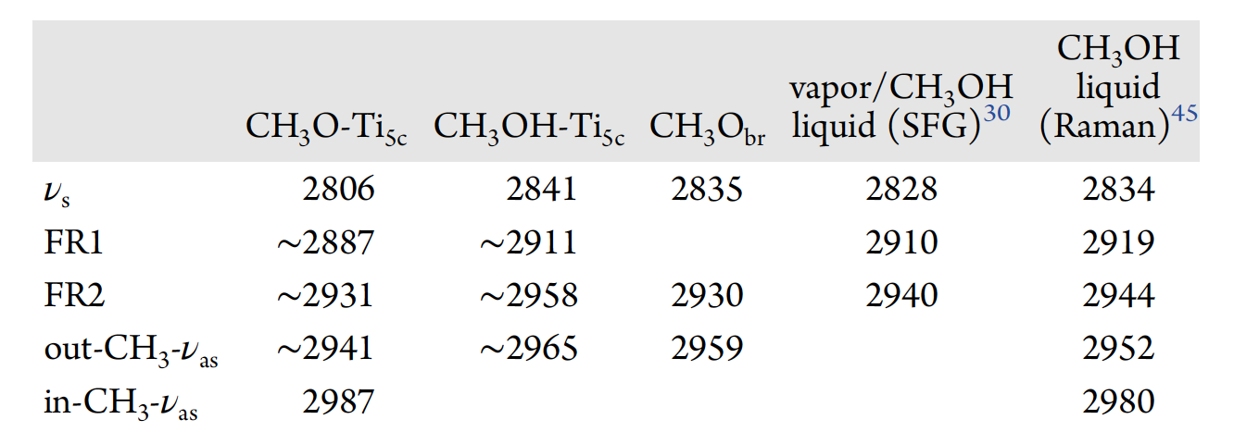
Summary of the assignments

Slide 21
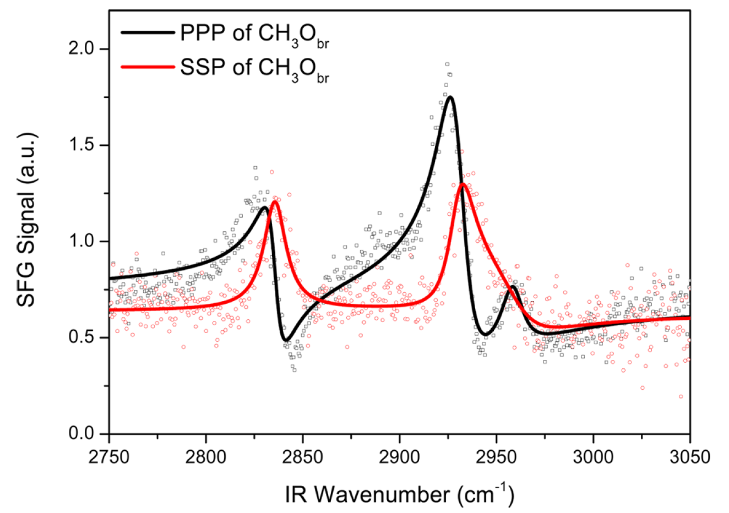
3.4 SFG Measurement of Methoxy at O_{br} Sites
Fig 4. SFG vibrational spectra with ssp and ppp polarization combinations of CH₃O_{br} on TiO₂(110).
Notes:
如何得到氧缺位的二氧化钛表面？实验中采用氩离子对表面进行喷溅处理，具体的就不说了，通过这样一个处理就能得到高度氧缺位的二氧化钛表明，通过量甲醇后在400K曝光，这样就把另外两种方式吸附的甲醇去除了，从而得到只有以氧替代的这种方式吸附的甲醇。结果只有三个峰可以分辨，与之前两种站位相比，除了共振频率的差别，有两个现象非常有趣。
第一，一共只有一个as峰被保留，就是前面图中最强的蓝色的as1峰保留了下来。这是在氧替代的这种吸附方式下，甲醇的主轴几乎垂直与表明，前面说过𝛳减小，as峰强迅速降低，因此，只有最强的蓝色的as1峰存活了下来。
第二，与前面两种相比，ppp偏振的非共振部分强度降低，ssp的非共振部分抬高。这可能是因为二氧化钛表明高度氧缺位改变了二氧化钛表面的电子结构，因此二氧化钛表明的sfg信号，也就是非共振部分的强度也会随之发生变化，只不过在两种偏振下这个变化趋势是相反的。

Slide 22
4. Conclusion and outlook
Overlapping FR and ν_{as} modes have been resolved.
ν_{as} modes of both methanol and methoxy and the ν_{as} splitting of methoxy on Ti_{5c} sites has been observed for the first time.
Methoxy on O_{br} vacancy sites was identified and its three modes were all resolved.
Further in situ photocatalytic reaction studies of methanol and other alcohol molecules on TiO₂ (110) at the molecular level.
Demonstrate the capabilities of the SFG-VS technique.

Slide 23
Thanks！

